Slide 1

E-commerce Dashboard Insights Report

Slide 2
Project Purpose: E-Commerce Sales Analysis Dashboard
The purpose of this project is to develop an interactive e-commerce dashboard that provides real-time insights into sales performance across various metrics and dimensions. The dashboard aims to empower business analysts and decision-makers with actionable data to optimize sales strategies, improve customer engagement, and enhance overall profitability.
Key Objectives:
Track Sales Metrics Monitor key performance indicators such as total sales amount, quantity sold, profit, and average order value.
Analyze Profit by Region Evaluate state-wise profit distribution to identify high-performing regions and tailor regional sales tactics.
Understand Payment Preferences Assess customer payment mode preferences, with a focus on the predominant Cash On Delivery method.
Category Sales Insights Gain insights into product category performance, especially the high sales volume of clothing items.
Customer Contribution Analysis Analyze individual customer contributions to sales and develop targeted marketing campaigns.
Monthly Profit Trends Observe monthly profit trends to plan for seasonal variations and promotional activities.
Product Category Profitability Investigate category-specific profitability to make informed decisions on inventory and product development.
This dashboard serves as a strategic tool for the e-commerce business, enabling a data-driven approach to enhancing sales performance and customer satisfaction 📈🛍️.

Slide 3
Skills Utilized in E-Commerce Dashboard Report
Data Analysis
Analysing sales data to extract insights.
Interpreting trends and patterns.
Data Visualization
Creating intuitive charts and graphs.
Customizing visual elements for clarity.
UX Design
Crafting user-friendly interfaces.
Ensuring responsive design.
Presentation Skills
Organizing information effectively.
Enhancing visual appeal.
Tools Used
[ MS Excel and Power BI ]

Slide 4
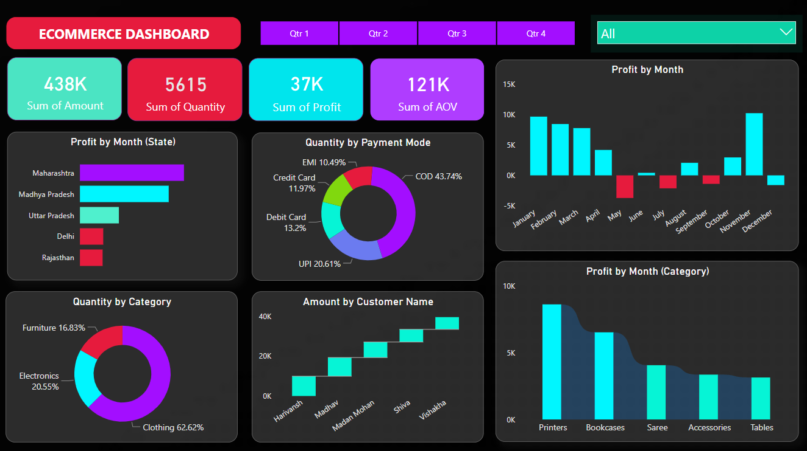

Slide 5
E-Commerce Sales Performance Overview
The dashboard presents a comprehensive view of the e-commerce sales data, highlighting significant metrics that reflect the business’s health and customer engagement. With a total sales amount of 438K and 5615 items sold, the business demonstrates a robust sales volume. The profit margin stands at 37K, indicating a healthy return on sales 📈🛍️.
State-Wise Profit Analysis Maharashtra emerges as the top-performing state, contributing significantly to the profit, followed by Madhya Pradesh and Uttar Pradesh. This regional analysis can guide targeted marketing strategies to further enhance sales in high-performing states.
Payment Mode Preferences Cash On Delivery (COD) is the preferred payment method, accounting for 43% of transactions. This preference for COD suggests that customers value the flexibility and security it offers.
Product Category Sales Clothing dominates the product categories with over 62% of the total items sold, signifying a strong market demand. This insight can inform inventory management and promotional activities to capitalize on the popularity of clothing items.
Customer Engagement The dashboard also sheds light on customer engagement, with varying amounts spent by different customers. This data can be leveraged to identify high-value customers and tailor personalized marketing efforts.
Monthly Profit Trends The monthly profit analysis reveals fluctuations in profitability, providing an opportunity to investigate the causes and implement measures to stabilize earnings throughout the year.
Category-Specific Profit Trends Examining profits by category, items like Printers and Bookcases show distinct trends, which can inform strategic decisions regarding product focus and development.

Slide 6
Once collected, this raw data is processed, cleaned, and transformed into a structured format. Analytical tools and business intelligence platforms, such as Power BI as mentioned in previous responses, are then used to perform in-depth analysis and derive meaningful insights. As the business landscape continues to evolve, E-commerce Sales data analytics dashboard will play an increasingly vital role in enabling a data-driven approach to enhancing sales performance and customer satisfaction 📈🛍️.

